Slide 1


Efficient alignment techniques for sequencing data using machine learning.
By Taonga Kandiwo

Slide 2
What is DNA
DNA, or deoxyribonucleic acid, is a molecule that carries all living species' genetic information(Sakata, 2009).
Nucleic acids are made up of DNA and its partner RNA, also known as ribonucleic acid. DNA is the structure in which all of a living being's biological information is stored.
DNA is a long, chain-like molecule made up of two strands twisted together to form a double helix. The two strands are made up of nucleotides, which are smaller molecules.
Each nucleotide is made up of one of the four nitrogen-containing nucleobases, cytosine (C), guanine (G), adenine (A), and thymine (T), as well as deoxyribose and a phosphate group.

Slide 3
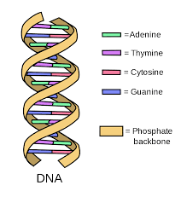

What is DNA
There are portions of our DNA that code for proteins, and there are regions that do not, both inside genes and across genes.
Exons are the protein-coding regions of genes, whereas introns are the spaces between exons within a single gene. "Non-coding regions" are the areas that exist between distinct genes.
https://www.ashg.org/discover-genetics/building-blocks/

Slide 4
What is DNA Sequencing?
The process of finding the exact order of nucleotides in a DNA molecule is known as sequencing(Kuo, 2010).
It is used to identify the order of the four bases in a strand of DNA: adenine (A), guanine (G), cytosine (C), and thymine (T).
Individual genes, complete chromosomes, and entire genomes of organisms are sequenced via DNA sequencing.
Sequencing DNA has also become the most effective method of sequencing RNA and proteins.

Slide 5
History of sequencing
The work of a British scientist called Frederick Sanger created the groundwork for protein sequencing.
Sanger finished the sequencing of all the amino acids in insulin in 1955. His research proved that proteins were made up of chemical entities with a defined pattern rather than a mix of things (Morey, 2013).
In 1977, Frederick Sanger and his colleagues invented a technology called Sanger Sequencing, which allowed DNA to be sequenced by creating fragments. For around 40 years, it was the most extensively used sequencing method.

Slide 6
Genome Sequencing and Sequence Assembly
A sequence of several hundred bases is produced by a DNA sequencing procedure. Thousands of bases make up most gene sequences.
The gene linked to Duchenne muscular dystrophy is the biggest known gene. It has a length of almost 2.4 million bases.
Shotgun sequencing is a basic approach that scientists employ to investigate a single gene in its entirety. A collection of shorter overlapping sequences make up the lengthy DNA sequence(Sakata, 2009).

Slide 7
Shotgun Sequencing
Sequencing machines are special devices that harvest short random DNA sequences from a genome that we want to figure out (target genome).
Current DNA sequencing technology are unable to read an entire genome in a single pass. Depending on the technology employed, it scans little chunks of between 20 and 30000 bases.
Reads are the term for these brief articles. To construct continuous strings known as contigs, special software is utilized to assemble these reads according to how they overlap. These contigs might be the entire target genome or only sections of it

Slide 8
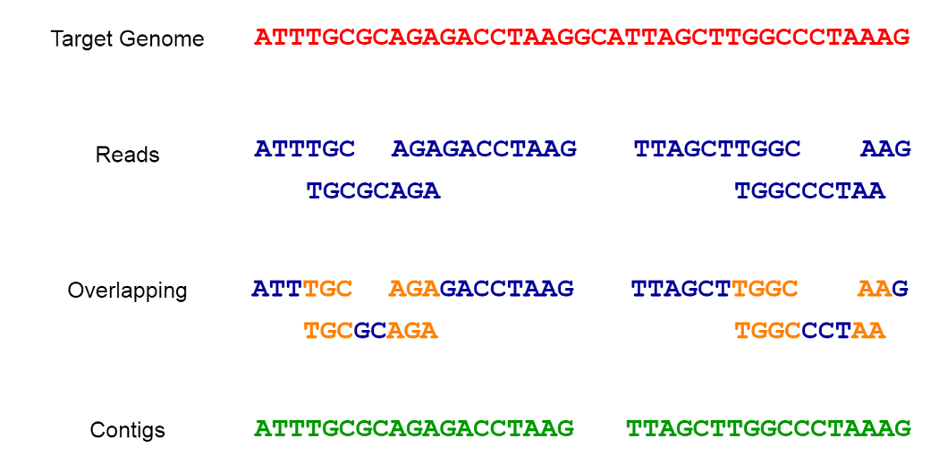
Shotgun Sequencing cont
Sequence Assembly is the process of matching and combining fragments from a larger DNA sequence in order to recover the original sequence.
We may need to generate more and more random reads until the contigs match the target genome in order to retrieve the whole genome sequence.
https://towardsdatascience.com/dna-sequence-data-analysis-starting-off-in-bioinformatics-3dba4cea04f

Slide 9
Problems faced in sequence assembly
The presence of repeated sequences in the genome, as well as alterations or mutations within them, creates a difficulty.
This issue is classified as NP-complete. Issues with an undetermined state are referred to be NP complete problems.
No polynomial-time algorithm has yet been developed for any NP complete problem, and no one has yet been able to show that none exist.
There are, however, greedy algorithms for solving the sequence assembly issue, which have shown to work rather well in practice in trials. Sequence alignment is a typical strategy for solving the sequence assembly issue and analyzing sequence data.

Slide 10
Sequence Alignment
Sequence alignment is a technique for identifying areas of similarity in DNA, RNA, or protein sequences(Staden, 2014).
The similarity seen between the sequences might be due to functional, structural, or evolutionary links.
Pairwise sequence alignment is when two sequences are compared. Multiple sequence alignment occurs when we compare more than two sequences.

Slide 11
Next-Generation Sequencing
Next-generation sequencing (NGS), often known as high-throughput sequencing, is a broad phrase that encompasses a variety of current sequencing techniques, including
  Illumina (Solexa) sequencing
  Roche 454 sequencing
  Ion torrent Proton / PGM sequencing
  SOLiD sequencing
These new tools have changed genomics research by allowing us to read DNA and RNA considerably more swiftly and inexpensively than previously possible using Sanger sequencing(Ansorge, 2009).

Slide 12
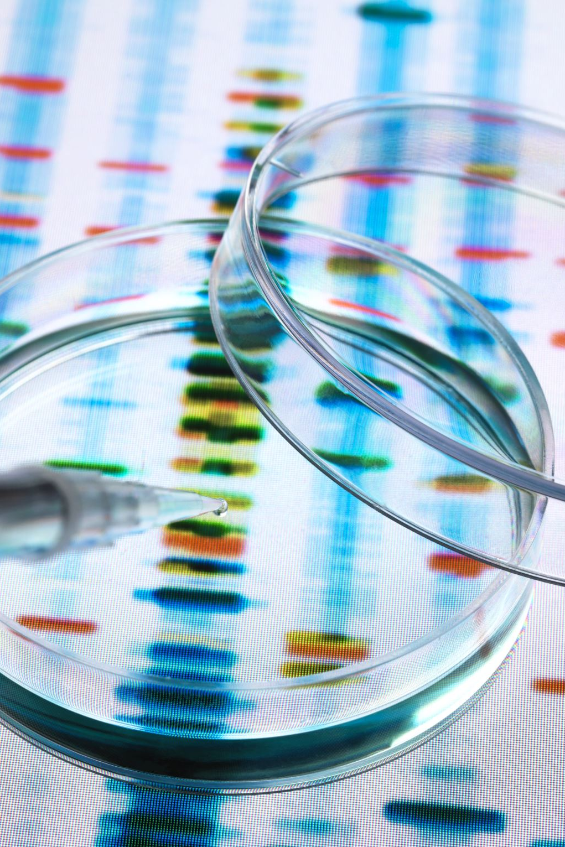
Next-Generation Sequencing
The Human Genome Project, which took over a decade to complete and used Sanger sequencing to identify a single individual's genome, was finished in 2003. The human genome can now be sequenced in a few of days.
Because NGS technologies sequence millions of little DNA fragments from many distinct areas of the genome at the same time rather than reading in a single DNA fragment from one region of the genome, they are quicker than Sanger sequencing.
Another advantage of NGS is that its sensitivity for detecting extremely low-level changes is substantially higher than that of Sanger sequencing. For NGS to work, just 2% to 5% of the DNA analyzed must have the same variation or mutation (disease-causing variant) in order to be discovered.

Slide 13
Machine Learning Algorithm
In the past few decades, we have witnessed the revolutionary development of biomedical research and biotechnology and the explosive growth of biomedical data.
On the one hand, the rapid development of biotechnology and biological data analysis methods has led to the emergence of a challenging new field: bioinformatics.
On the other hand, the continuous development of biological data mining technology has produced a large number of effective and well-scalable algorithms.

Slide 14
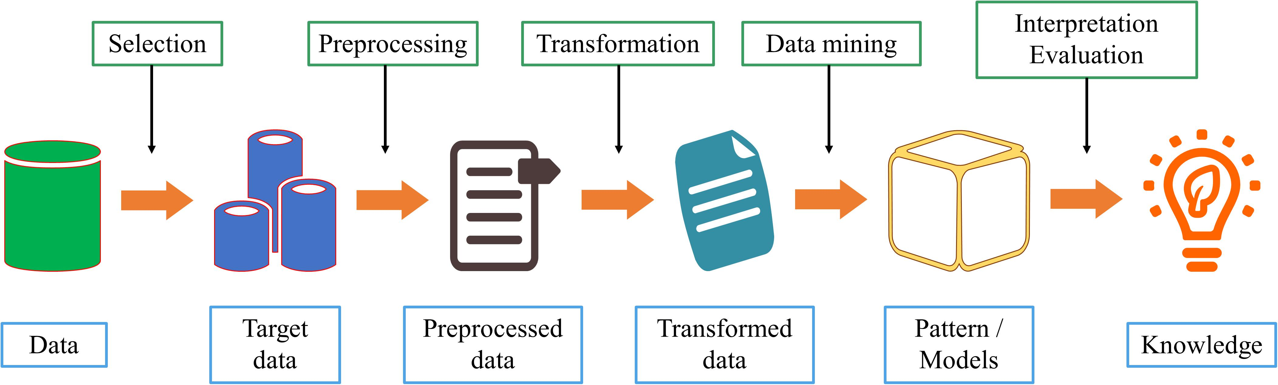
Basic Process of Data Mining
Data mining is a discipline that combines classic statistical tools with computer science algorithms.
This discipline aims to mine knowledge from large amounts of data for scientific, computational, or industrial use.

Slide 15
Basic Process of Data Mining
Data cleaning. Because of the increasing amount of heterogeneous data, data sets often have missing data and inconsistent data. Low data quality will have a serious negative impact on the information extraction process. Therefore, deleting incomplete, or inconsistent data is the first step in data mining;
Data integration. If the source of the data to be studied is different, it must be aggregated consistently;
Data selection. Accurately select relevant data based on the research content;
Data conversion. Transform or merge data into a form suitable for mining, and integrate new attributes or functions useful for the data mining process;
Data mining. Select the appropriate model according to the problem and make subsequent improvements;
Mode evaluation. After acquiring knowledge from the data, select appropriate indicators to evaluate the model.

Slide 16
Application of Machine Learning in DNA Sequence Data Mining
Sequence alignment can be divided into double sequence alignment and multi-sequence alignment.
Multi-sequence alignment is an extension of double sequence alignment. As the number of sequence alignments increases, the difficulty of alignment is also greater.
At present, the research of biological sequence alignment is very mature, and a large number of sequence alignment tools have appeared, such as CLUSTAL, TCOFFEE, and MUSCLE.

Slide 17
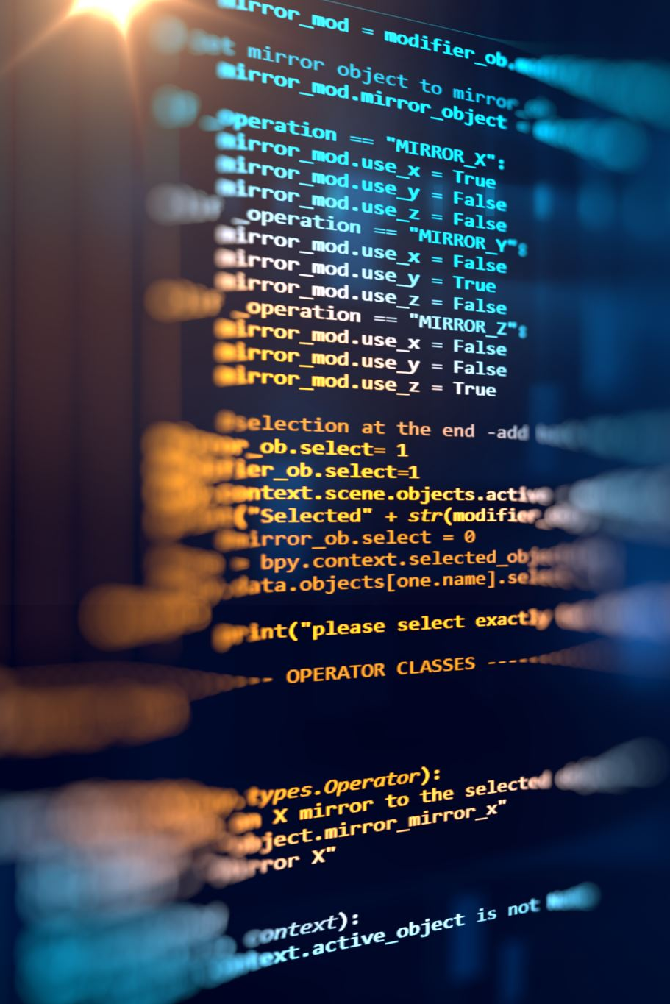
Application of Machine Learning in DNA Sequence Data Mining
At the early stages, research on biological sequence alignment started with dual sequence alignment.
Needleman and Wunsch used dynamic programming algorithms for dual sequence alignment based on the similarity of the entire sequence, this is the Needleman-Wunsch algorithm commonly used in sequence alignment, which is also known as global sequence comparison method and optimization matching algorithm.
Smith and Waterman (1981) improved the dynamic programming algorithm to make it into a local optimal algorithm, which can search for sequence fragments with the high local similarity between two sequences.

Slide 18
DNA Sequence Pattern Mining
During DNA evolution, its sequence patterns are well conserved, which is of great significance for biological research.
The DNA sequence pattern is usually a sequence fragment in the DNA sequence that has a specific function. In the process of DNA evolution, the more conserved regions in most sequences will form specific sequence patterns, and the structure and function of these sequences play an important role.
Therefore, identifying these patterns is an important research content of DNA sequence data analysis. This helps to predict DNA sequence function and explain the evolutionary relationship between sequences.
The purpose of DNA sequence pattern mining is to find such sequence patterns from DNA sequences and to identify genes and their functions.

Slide 19
DNA Sequence Pattern Mining
Existing sequential pattern mining algorithms can be roughly divided into two categories:
(1) One type of sequential pattern mining algorithm is to search for patterns in the sequence that exceed a certain threshold: mining alternative patterns. They can only mine alternating patterns in a single sequence.
(2) However, in the study of biological sequence analysis, we often require simultaneous analysis of sequence patterns in sequence sets, which cannot be achieved by this method.
Therefore, another type of sequence pattern mining algorithm is needed. This type of sequence pattern mining algorithm mines repeated sequence patterns in data sets. When we face massive amounts of biological data, such algorithms usually search very slowly.

Slide 20
Open Issues
There are still efficiency challenges when processing large-scale DNA sequence data;
For different biological needs, suitable DNA sequence data mining algorithms should be designed according to the corresponding background knowledge and sequence characteristics;
How to extract the sequence characteristics of DNA sequences and how to design an effective similarity measure to measure sequence similarity is very important;
Due to the “black box” nature of machine learning, the output of machine learning is difficult to give a reasonable explanation from a biological perspective, which limits the application of the model to a certain extent.

Slide 21
Ethical Issues
The ownership of an individual's DNA and the data generated when that DNA is sequenced is a major issue. In terms of the DNA molecule itself, the primary legal decision on the subject, held that people have no property rights to discarded cells or any profits gained utilizing these cells.
One concern is that insurers may use an individual's genomic data to modify their quote, depending on the perceived future health of the individual based on their DNA.
DNA that has been "abandoned," such as that found on a licked stamp or envelope, a coffee cup, a cigarette, chewing gum, household trash, or hair that has fallen on a public sidewalk, can be legally collected and sequenced by anyone, including the police, private investigators, political opponents, or people involved in paternity disputes, in most of the United States.

Slide 22
Uses of DNA sequencing
Targeted sequencing—sequencing of select variants or areas within a gene’s exons or full exons (the segments of DNA that code for proteins). When there is a known effect of certain types of changes to one or more genes, it may help guide medical care to only test for these known changes.
Sequencing all exons of a gene, including non-coding regions, is known as single gene sequencing. Sequencing the FBN1 gene is an example of this. Marfan syndrome is an illness that affects the connective tissue that makes up many sections of the body, including bones, muscles, ligaments, blood vessels, and heart valves, and is caused by mutations in this gene(Weipoltshammer, 2014).
Sequencing the genome or exome of newborns with uncommon metabolic diseases or children with developmental delays and/or intellectual impairments are instances of whole genome or whole exome sequencing.
Microbe whole genome sequencing—in addition to human genome sequencing, whole genome sequencing may be used to sequence the genomes of other species. Sequencing the genomes of microorganisms in suspected outbreaks is one example.

Slide 23
Which Technique to use
The sequencing method used is determined by the project's research questions and aims, which will assist define the throughput, read length, and accuracy requirements, as well as the sample types available.
Sanger sequencing is widely employed as an orthogonal approach to evaluate variations found by NGS since it remains the gold standard for base-calling applications where precision is crucial.
This is because NGS allows for the simultaneous interrogation of hundreds to thousands of genes in multiple samples, as well as the discovery and analysis of a variety of genomic features in a single sequencing run, including single nucleotide variants (SNVs), copy number and structural variants, and even RNA fusions(Weipoltshammer,2007).

Slide 24
References
Kuo, M. Tien. “Analysis of DNA Attached to the Chromosome Scaffold.” The Journal of Cell Biology, vol. 93, no. 2,2010, pp. 278–84, http://www.jstor.org/stable/1609685.
Weipoltshammer, Klara, et al. “Intranuclear Anchoring of Repetitive DNA Sequences: Centromeres, Telomeres, and Ribosomal DNA.” The Journal of Cell Biology, vol. 147, no. 7, 2007, pp. 1409–18, http://www.jstor.org/stable/1619643.
Ansorge, Wilhelm J. "Next-generation DNA sequencing techniques." New biotechnology 25.4 (2009): 195-203.
Staden, Rodger. "A strategy of DNA sequencing employing computer programs." Nucleic acids research 6.7(2014): 2601-2610.
Sakata, Toshiya, and Yuji Miyahara. "DNA sequencing based on intrinsic molecular charges." Angewandte Chemie 118.14 (2006): 2283-2286.
Morey, Marcos, et al. "A glimpse into past, present, and future DNA sequencing." Molecular genetics and metabolism 110.1-2 (2013): 3-24.

