Slide 1

Loneliness & it’s effects on College Students
Michael Harper
November 18, 2022

Slide 2

What is loneliness?
Loneliness is defined as a distressing feeling that accompanies the perception that one's social needs are not being met by the quantity or especially the quality of one's social relationships
It’s a universal human emotion that is both complex and unique to each individual. It has no single common cause and almost everyone experiences this. However, adolescents and young adults are affected the most.

Slide 3
What is loneliness? (Cont.)
Common definitions of loneliness describe it as a state of solitude or being alone, however, loneliness is a state of mind. Loneliness causes people to feel empty, alone, and unwanted. People who are lonely often crave human contact, but their state of mind makes it more difficult to form connections with other people.
Researchers suggest that loneliness is associated with social isolation, poor social skills, introversion, and depression.
Loneliness, according to many experts, is not necessarily about being alone. Instead, if you feel alone and isolated, then that is how loneliness plays into your state of mind.
For example, a college freshman might feel lonely despite being surrounded by roommates and other peers. A soldier beginning their military career might feel lonely after being deployed to a foreign country, despite being constantly surrounded by other troop members.

Slide 4
Loneliness vs. Solitude
While research clearly shows that loneliness and isolation are bad for both mental and physical health, being alone is not the same as being lonely. In fact, solitude actually has a number of important mental health benefits, including allowing people to better focus and recharge.
  Loneliness is marked by feelings of isolation despite wanting social connections. It is often perceived as an involuntary separation, rejection, or abandonment by other people.
  Solitude, on the other hand, is voluntary. People who enjoy spending time by themselves continue to maintain positive social relationships that they can return to when they crave connection. They still spend time with others, but these interactions are balanced with periods of time alone.

Slide 5
Types of Loneliness
Emotional loneliness is the absence of a significant other with whom a close attachment or meaningful relationship existed (a partner or close friend).
Social loneliness is the lack of a wider social network of friends, neighbours or colleagues.
Existential loneliness is described as a universal aspect of the human condition which expresses the separateness of the person from others.

Slide 6
Existential Loneliness
From an existential perspective, a little bit of existential loneliness is good for the soul, and it is definitely an inevitable part of the human experience. However, loneliness tends to stir up negative feelings, and while those can be helpful in terms of self-exploration, they are also something to which we are averse and want to avoid as much as we can.

Slide 7
Combating Existential Loneliness
The saying that you are born into this world alone, and you go out alone, suggests that existential loneliness is an inescapable aspect of life. It can be terrifying for some people to recognize just how alone we all are in this world, even if you have friends and family who love and support you 24/7, no matter what.
Existential fears, including the fears of isolation, death, meaninglessness, and freedom, are experienced by virtually all of us at some point in time. Recognizing the fear and using it as a motivator to live more fully and more in the moment can help us immerse ourselves in the present, which might help us recognize that we are among a vast sea of individuals struggling against these fears just as we are.

Slide 8

Emotional Loneliness
This type of loneliness arises from a feeling that you lack relationships or attachments. You might experience emotional loneliness when everyone but you has a romantic partner in your group. Emotional loneliness can be felt when you need someone to talk to about something going on in your life but feel that there is no one available to contact. If your heart has broken, you might feel lonely for the person who has moved out of your life. You might be lonely for a close friend, a parent, a sibling, and so on.

Slide 9
Combating Emotional Loneliness
The lasting solution to emotional loneliness is to establish and maintain a healthy support system. You can’t make “instant friendship” happen or find a “soulmate” overnight, but you can maximize your chances of deepening a friendship by reaching out to friends and being willing to be the one to suggest a meet-up or get together.
Waiting around for someone to make the first move is not taking a proactive stance, and because loneliness already reflects a sense of isolation, if you make the effort to reach out to others, you may be pleasantly surprised at how much better you can begin to feel, even if you just exchange a couple of texts with a friend or have a brief conversation on the phone.

Slide 10

Social Loneliness
This type of loneliness occurs when you don’t feel a sense of belonging to a group beyond yourself. You might even feel social loneliness even when you’re in a romantic relationship with a partner you treasure. If you don’t have a wider circle of social support, you may feel that you, or you and your partner, don’t have a group with whom you belong. When you walk into a party and don’t recognize anyone familiar, a feeling of social loneliness may wash over you if you don’t typically feel comfortable approaching new people. If you don’t feel that your presence is valued in a wider circle, you might experience social loneliness.

Slide 11

Combating Social Loneliness
This feeling arises when we feel left out of a larger group. It might be the way you felt when you walked into the high school cafeteria the first day back at school in the fall and couldn’t immediately locate any friendly faces to join at their table. Exclusion from a group can be painful, even if it’s not intentional. An easy way to combat social loneliness is to jump into a new activity or group.
Maybe a new fitness club is opening in the neighborhood, or an “Introduction to Fiber Arts” class is forming at the rec center, or a “Beginner’s Axe Throwing workshop” is starting; volunteer at the animal shelter or at the community food bank; whatever is intriguing to you, show up! If everyone in the room is “new,” it can be easier to strike up conversations and new friendships.
If you and your partner feel like you don’t have a shared network of friends, join a beginner’s rhumba or foxtrot or salsa dance class. Get involved in volunteering together, whether it’s building houses or stuffing envelopes or delivering meals to the homebound.

Slide 12
Effects of Loneliness
Mental and physical health are interconnected. Social isolation and loneliness's adverse health consequences range from sleeplessness to reduced immune function. Loneliness is associated with higher anxiety, depression, and suicide rates. Isolation and loneliness are also linked to poor cardiovascular health and cognitive function:
  A study led by an epidemiologist at Newcastle University concluded that deficiencies in social relationships are associated with a higher risk for coronary heart disease and stroke.
  A study published in The Journals of Gerontology concluded that loneliness was associated with a 40 percent increase in the risk of dementia.
Links between social isolation and serious medical conditions are not fully understood, but ample evidence supports the connection. A study published in the American Journal of Epidemiology linked social isolation with higher risks of premature mortality. The Centers for Disease Control and Prevention (CDC) points to loneliness and isolation as serious public health risks.

Slide 13
Health Risks Associated
Loneliness has a wide range of negative effects on both physical and mental health, including:
  Alcohol and drug misuse
  Altered brain function
  Alzheimer's disease progression
  Antisocial behavior
  Cardiovascular disease and stroke5
  Decreased memory and learning
  Depression and suicide
  Increased stress levels
  Poor decision-making

Slide 14

Health Risks Associated (cont.)
The previous health risks aren’t the only areas in which loneliness takes its toll. For example, lonely adults get less exercise than those who are not lonely. Their diet is higher in fat, their sleep is less efficient, and they report more daytime fatigue.
Loneliness also disrupts the regulation of cellular processes deep within the body, predisposing lonely people to premature aging.

Slide 15
Loneliness on Campus
In a 2017 survey of nearly 48,000 college students, 64% said they had felt “very lonely” in the previous 12 months, while only 19% reported they never felt lonely, according to the American College Health Association. Students also reported feeling “overwhelming anxiety (62%) or “very sad” (69%), and that “things were hopeless” (53%). Nearly 12% seriously considered suicide.

Slide 16
How Are College students affected?
College students who are lonely often describe themselves as shy and/or depressed, empty, hopeless, restless, alienated, anxious, and unloved.
This includes negative evaluations of their own bodies, sexuality, health, appearance, behavior, and functioning. They are also more introverted and feel their lives are directed by forces outside their control.
Overall, they are less talkative or talk more about themselves, ask fewer questions of their partners, make fewer partner references during the discussions, and change the topic under discussion more. Lonely students are also less effective nonverbal.

Slide 17
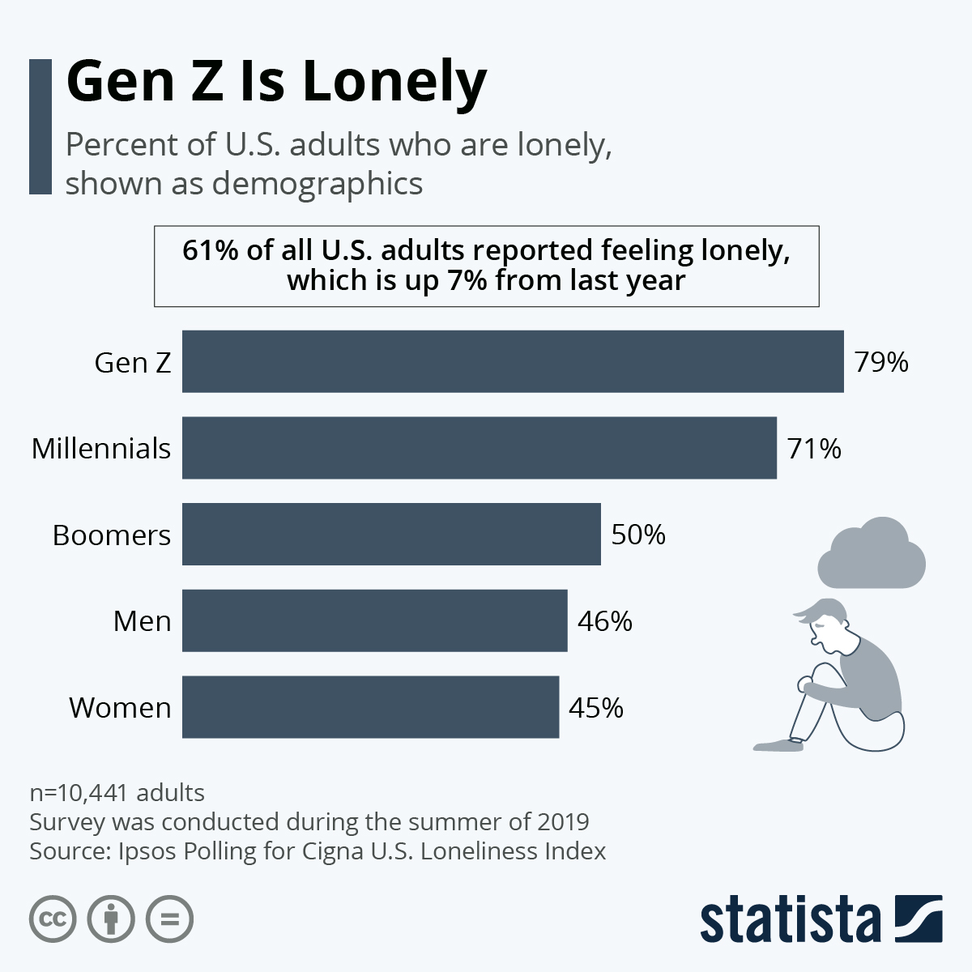

Slide 18
Measuring loneliness
It is important to measure loneliness because, although it has been found to be associated with a range of poor health outcomes, the evidence on loneliness is currently quite patchy. We have much more robust and extensive data on loneliness in older people, but much less for other age groups including children and young people. We also need to understand more about what factors are most associated with loneliness, what the effects of loneliness are for different people, and how we can prevent or alleviate it.
Many different approaches have been used to measure loneliness. These include both loneliness multi-item scales and single-item measures. Some measures ask about loneliness directly while others ask about emotions associated with loneliness from which loneliness is then inferred. There are advantages and disadvantages associated with each.

Slide 19

Measuring Loneliness
Specifically, we recommend four questions to capture different aspects of loneliness. The first three questions are from the University of California, Los Angeles (UCLA) three-item loneliness scale. The wording of the UCLA questions and response options are taken from the English Longitudinal Study of Ageing. The last is a direct question about how often the respondent feels lonely, currently used on the Community Life Survey.

Slide 20
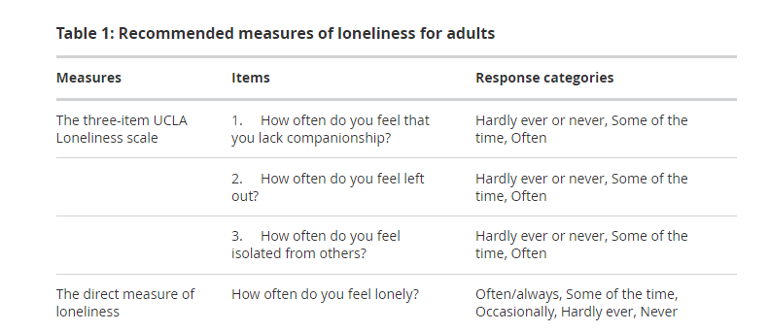

Slide 21
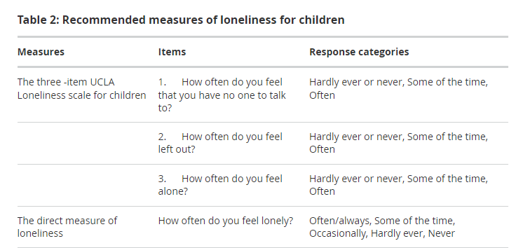

Slide 22
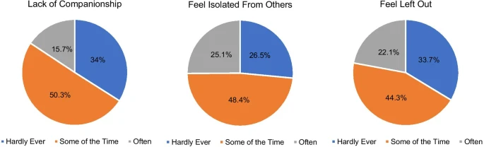
Loneliness among adolescents and young adults with cancer during the COVID-19 pandemic

Slide 23
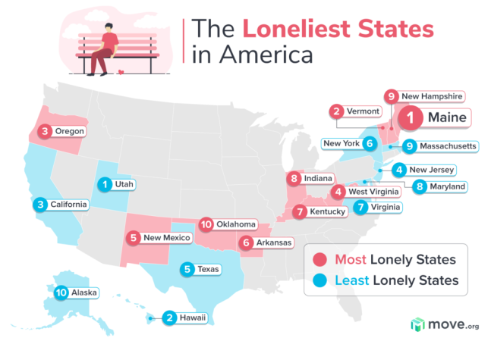

Slide 24
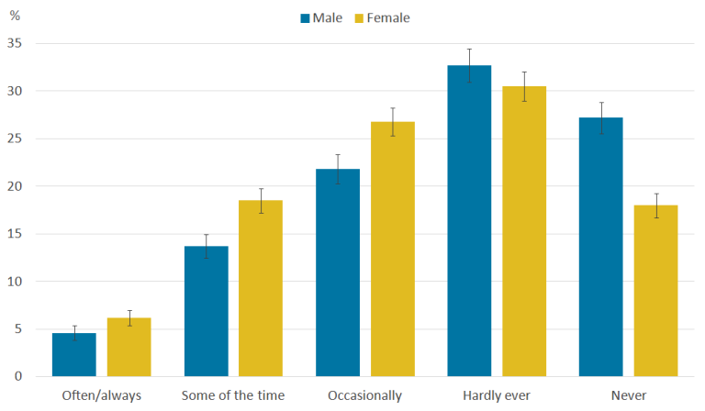
Reported Frequency Of Loneliness By Sex

Slide 25

Proposal
An app on campus that works as a virtual venting box, and additionally as a space for students to connect and coordinate with each other.
Students would be able to submit their thoughts and feelings anonymously and respond anonymously. Students would have to sign up with their information that way the app would know who they are in case they post something that seems threatening to themselves or others.

Slide 26

Proposal (cont.)
On the connectivity and coordination side, the app would double as a space for students to easily post an event they may plan or want to host, and other students would be able to see.
Some examples being:
  A Study Group
  A Quick Basketball Game
  School Hosted Events
  Parties

Slide 27
Objectives
Combat Loneliness in Students
  Increase Socialization
  Increase Student Moral
  Connect Students
  Show Students they Aren't Alone

Slide 28
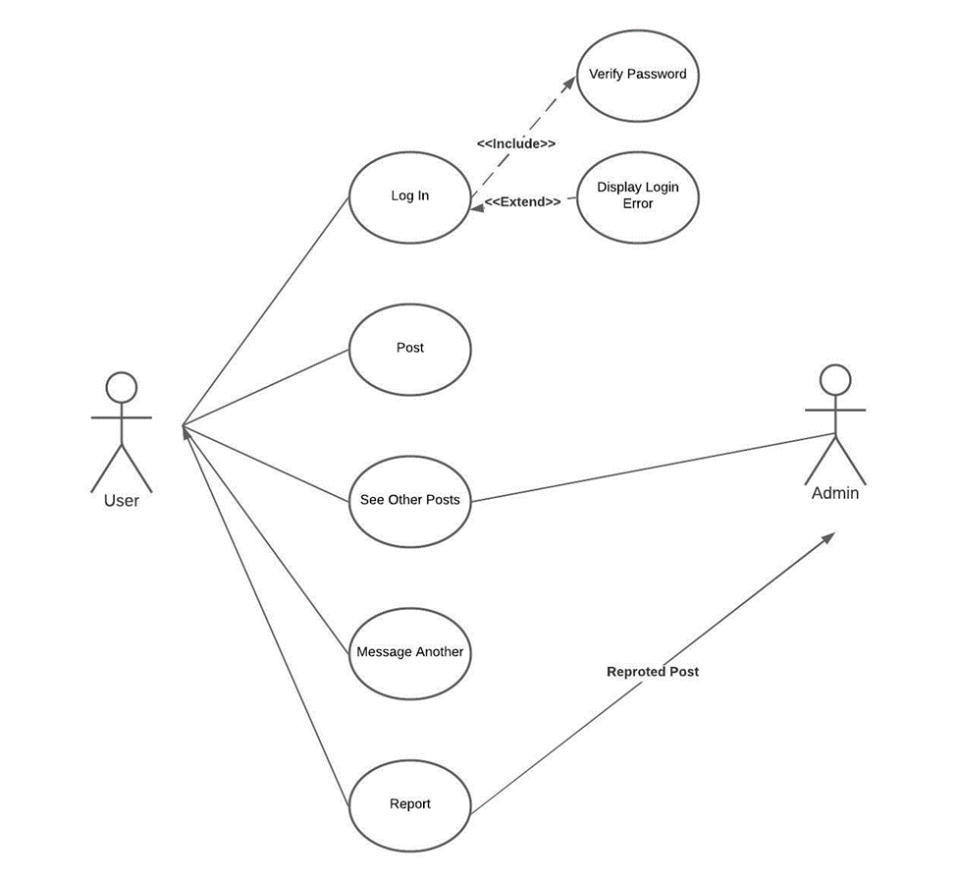
UML Design

Slide 29
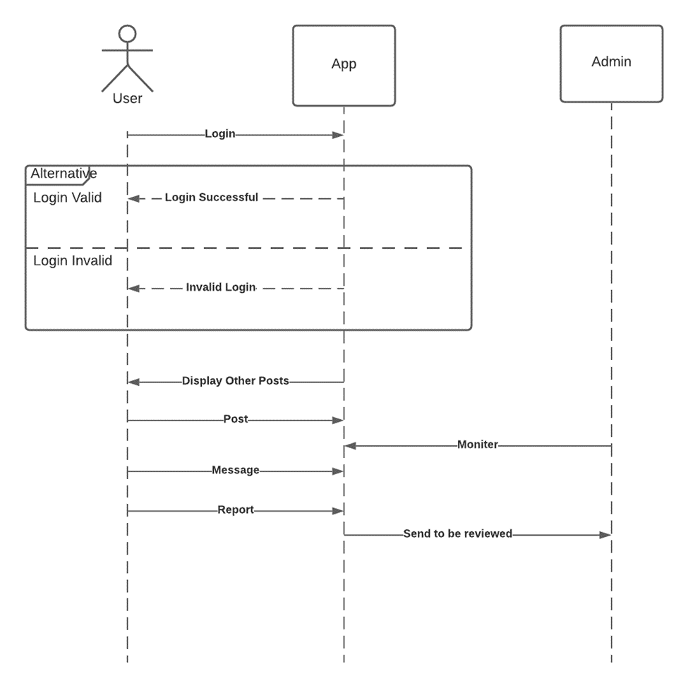
Sequence Diagram

Slide 30
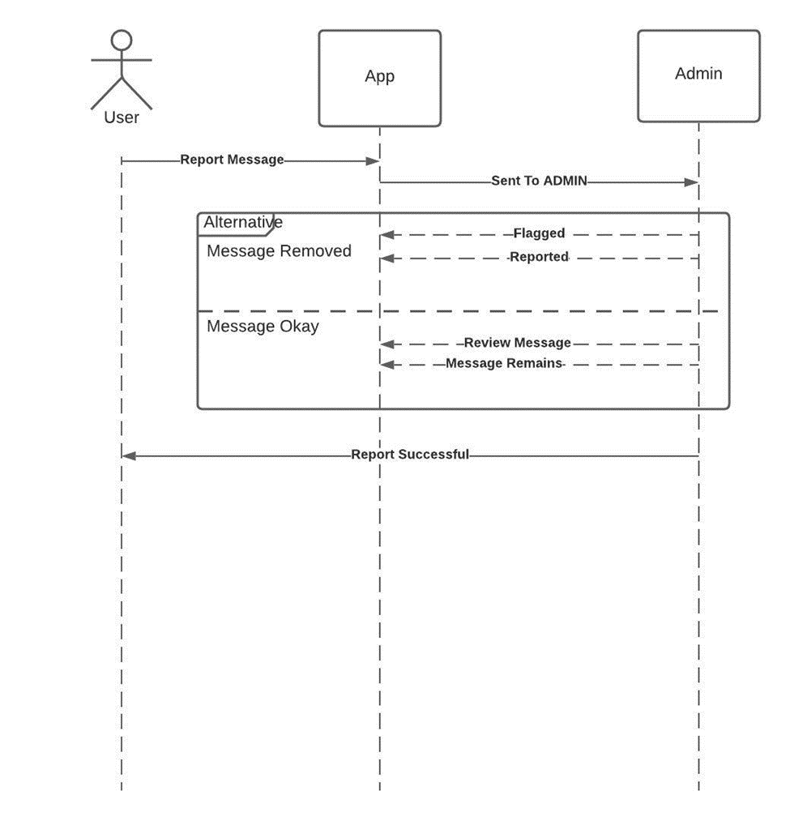
Diagram Showing Report System

Slide 31
Conclusion
Feeling connected to others is important for our mental and physical wellbeing and can protect against anxiety and depression. If you feel alone or socially isolated for a long time, you might experience physical or mental problems or do things that are bad for you. Without adequate treatment or outreach, young adults experiencing a mental health issue are more likely to receive lower grade point average, drop out of college, or be unemployed than their peers without a mental health challenge.
Without being able to know everyone’s unique situation, it’s important to encourage and promote and healthy connected environment for students to prosper and succeed.

Slide 32
References
Snyder, D. G. (2014). Hardnessing the Power of Loneliness: A Social Functional Approach to Loneliness at Work. Academy of Management Annual Meeting Proceedings, 1, 14066-14066. http://doi.org/10.5465/AMBPP.2014.14066abstract
Ponzetti, James J. “Loneliness among College Students.” Family Relations, vol. 39, no. 3, 1990, pp. 336–40. JSTOR, https://doi.org/10.2307/584881 . Accessed 16 Sep. 2022.
Zhou, X. (2018) A Review of Researches Workplace Loneliness. Psychology, 9, 1005-1022. doi: 10.4236/psych.2018.95064.
Theeke, L. , Mallow, J. , Moore, J. , McBurney, A. , VanGilder, R. , Barr, T. , Theeke, E. , Rellick, S. and Petrone, A. (2016) Using Gene Expression Analysis to Examine Changes in Loneliness, Depression and Systemic Inflammation in Lonely Chronically Ill Older Adults. Open Journal of Nursing, 6, 620-631. doi: 10.4236/ojn.2016.68066.
Hu, Y. , Jin, Y. , Hu, C. & He, H. (2013). Loneliness and Their Relationship to Explicit and Implicit Self-Esteem. Psychology, 4, 455-458. doi: 10.4236/psych.2013.45064.

Slide 33
References
Snyder, D. G. (2014). Hardnessing the Power of Loneliness: A Social Functional Approach to Loneliness at Work. Academy of Management Annual Meeting Proceedings, 1, 14066-14066. http://doi.org/10.5465/AMBPP.2014.14066abstract
Ponzetti, James J. “Loneliness among College Students.” Family Relations, vol. 39, no. 3, 1990, pp. 336–40. JSTOR, https://doi.org/10.2307/584881 . Accessed 16 Sep. 2022.
Zhou, X. (2018) A Review of Researches Workplace Loneliness. Psychology, 9, 1005-1022. doi: 10.4236/psych.2018.95064.
Theeke, L. , Mallow, J. , Moore, J. , McBurney, A. , VanGilder, R. , Barr, T. , Theeke, E. , Rellick, S. and Petrone, A. (2016) Using Gene Expression Analysis to Examine Changes in Loneliness, Depression and Systemic Inflammation in Lonely Chronically Ill Older Adults. Open Journal of Nursing, 6, 620-631. doi: 10.4236/ojn.2016.68066.
Hu, Y. , Jin, Y. , Hu, C. & He, H. (2013). Loneliness and Their Relationship to Explicit and Implicit Self-Esteem. Psychology, 4, 455-458. doi: 10.4236/psych.2013.45064.

Slide 34

Thank you
Michael Harper

