Slide 1
The Possibility of Achieving Full-Dive Virtual Reality
Kurt Abraham
Department of Biology, Claflin University
CSCI-391-01: Junior Seminar
Dr. Shrikant Pawar
October 17, 2022

Slide 2


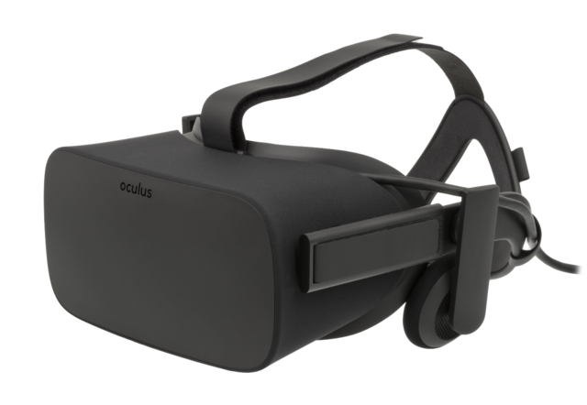
Introduction
Virtual Reality (VR) consists of technology that can immerse their users in a fully virtual world, primarily utilizing their sight and spatial controllers.
Technology that is commercially available serves its purpose with regards to immersing users via their sight, but this is merely scratching the surface of the immersion that virtual worlds can display to their inhabitants.

Slide 3
Introduction
Technology that is currently being researched pertain to at least one subcategory of VR, that being augmented reality (AR), mixed reality (MR), extended reality (XR), and full-dive virtual reality.
AR projects virtual assets onto the physical world, though the virtual assets cannot interact with physical objects directly.
MR attempts to merge the virtual world and physical world, enabling virtual and physical objects to interact with one another.
XR is an umbrella term that blankets other terms pertaining to the virtual world, including but limited to VR, AR, MR, and XR.

Slide 4

Introduction
The concept of full-dive virtual reality is a virtual world indistinguishable from our own for humans to inhabit, utilizing a vast assortment of technology to become completely immersed.
Our five main senses are sight, sound, touch, taste, and smell.
Standard VR goggles can only utilize our sight and sound, and current technology cannot perfectly utilize these senses.
Peripheral devices and gadgets that attempt to utilize our sense of touch exist, though most of these devices and gadgets are not advanced enough to properly immerse their users in the virtual world.

Slide 5
Introduction
There are many aspects of the human experience that must be catered to in order to achieve full-dive virtual reality, such as emotions, instincts, and socialization.
Not only can these experiences distract the user from the physical world that they live in, but they can also be recorded and incorporated into changes to the full-dive experience.

Slide 6
Method
The purpose of this research is to devise whether it is possible to achieve full-dive virtual reality in the foreseeable future.
If it is possible, how should we go about creating said technology that supports full-dive virtual reality?
If it is not possible, what direction should research about virtual world technology go?

Slide 7
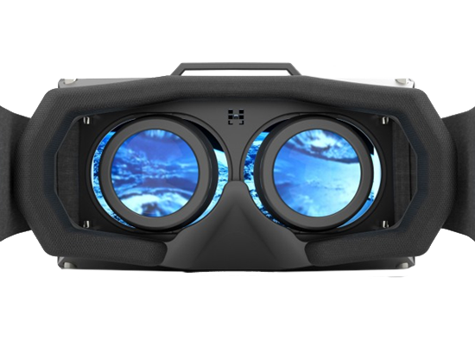
Method
Current technology geared toward the virtual world prioritizes sight most of all the five main senses.
It is one of the most crucial senses that contributes to experience of humans who are not blind, as well as a sense that is easily deceived via high-definition displays today.
VR goggles encapsulate a majority of our field of vision, projecting two slightly different images to give a sense of depth of field to the user.

Slide 8
Method
The functionality of VR goggles alone are marketable to the general public, but in order to achieve full-dive, there are a plethora of issues that must be resolved.
While the field of vision that VR goggles encapsulate is vast, it is not perfect.
If high-definition displays are to remain our method of utilizing the sense of sight for full-dive virtual reality, the field of vision must be expanded upon, such that our entire field of vision is encapsulated.

Slide 9
Method
Another issue is the quality of the displays that we utilize.
High-definition displays can immerse full-dive users for a time, but after prolonged use, the user may start noticing some pixels with the right circumstances.
Increasing the quality of the displays can subvert this issue, though it will require more power and possibly a heavier device.

Slide 10
Method
The weight of the device that contains the high-definition display is another issue, as it is far from natural to have such a weight over one’s head.
Most VR goggles are strapped onto one’s head and fastened with straps so that it will not fall off during use.
This grip onto the head with the weight can easily become uncomfortable for its users, especially those with intricate or large hairstyles, such as afros.
Over time as technology advances, the weight of traditional VR goggles will decrease, but to truly achieve full-dive virtual reality, the weight of the device must be practically unnoticeable.

Slide 11
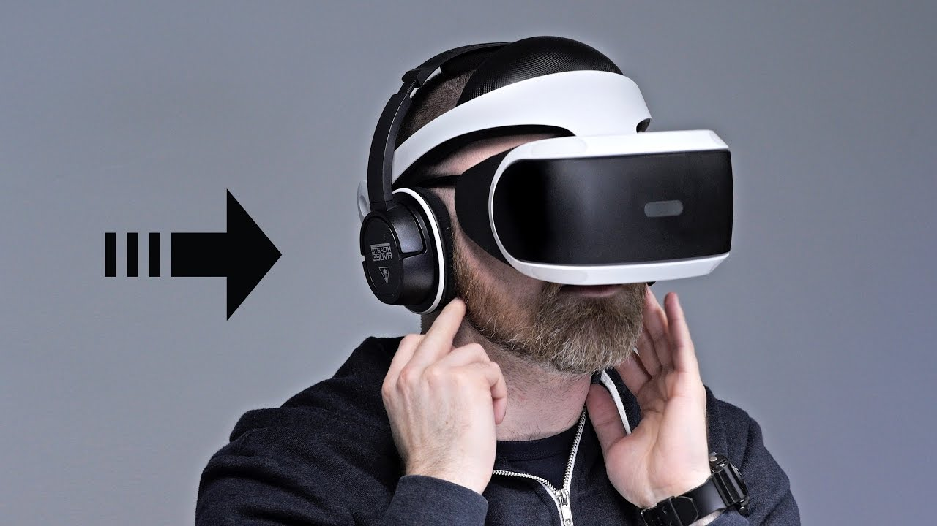
Method
The second of our five main senses that VR technology is geared toward is our sense of sound.
Without the ability to hear what we are observing, it is easy for those who are not deaf to lose immersion in an otherwise immersive experience.

Slide 12
Method
Many devices provide spatial audio output, such as headphones and tv speakers.
While these devices do provide the user with a level of variation with regards to the direction of the source of sound, their area of coverage is a far cry from the span of directions in real life.
Headphones cover left and right well, but anything above, below, in front of, or behind the user will be more difficult to discern.
This can cause immersion to be broken in situations where audio plays a key role in an experience, and thus full-dive will not be achieved perfectly.

Slide 13
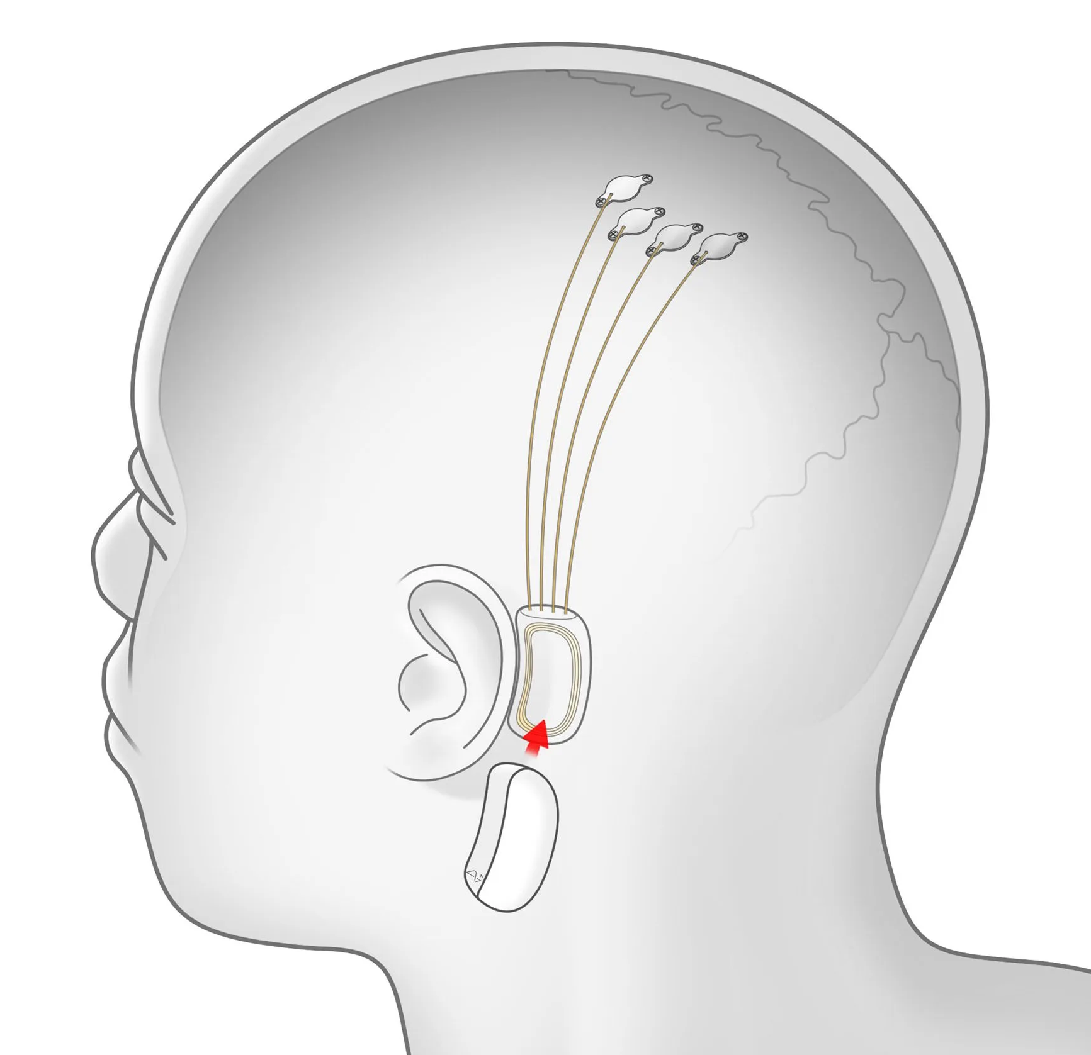
Method
This problem can be circumvented with thorough neural research, as sending signals to the brain coded to tell the brain that “this sound came from this direction” will enrich the audible immersion with almost anyone, boosting our chances of achieving full-dive virtual reality.
There is current research that pertains to sending and receiving signals to and from the brain, such as the Neuralink, but such technology is not expected to become commercially available for the near future.

Slide 14
Method
If we are to ignore a direct connection on the brain and rather focus on a spherical audio output device, such a device will surely be impractical.
A helmet of sorts with speakers placed on the inner walls of it will be uncomfortable to wear in most situations and will likely weigh heavier than traditional VR goggles to boot.
A pod that contains the body will be too large for use without proper preparation, and even with preparation it will likely restrict natural movement, breaking immersion.
To achieve true full-dive virtual reality with these restrictions, we must either make a direct connection to the brain or devise a way to minimalize the presence of a helmet.

Slide 15
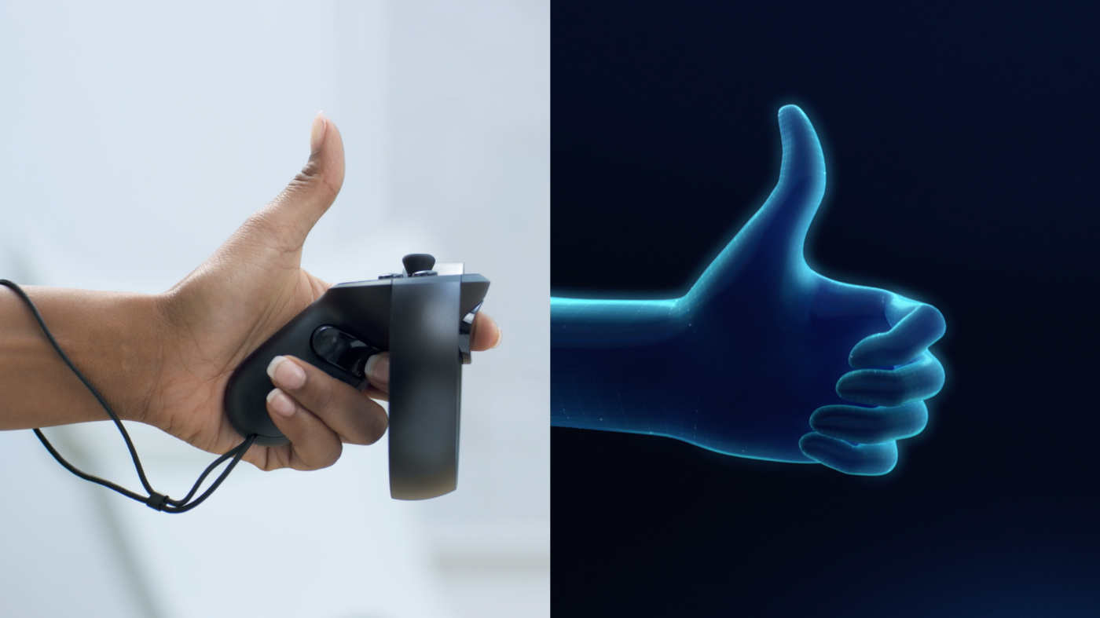
Method
Our sense of touch is the third sense that we rely heavily on to immerse ourselves into our environment, be it the physical world or virtual world.
When you walk, you expect to feel pressure on your feet.
When you grab something, you expect to be met with resistance that causes your hand to curl around the object.
When you lean against a wall, you expect to be stopped from falling.

Slide 16
Method
Current commercially available technology fails to solve every issue that occurs with regards to immersing ourselves with our sense of touch, some causing more issues than they solve.
Track pads allow you to walk in the virtual world while being stationary in the real world, but devices that enable this restrict other movements that you could otherwise make.
Hand tracking gloves can simulate resistance in such a way that your hands curl around a virtual object, but not only are you wearing gloves, but you cannot feel the texture of the object you are virtually grabbing.
Creating a virtual environment catered to a physical room will enable users to lean against walls, but the experience of leaning on walls will be limited to that specific room with a specific program.

Slide 17
Method
There are no current technologies that can perfectly simulate our sense of touch, and commercial devices only immerse their user in specific touch-based experiences while restricting others.
While focusing on a specific experience with touch-based devices one can be immersed, but after extended use, even easily immersed users will desire the feeling of textures.
Until research on direct connections with the brain is completed and technology enables such research to become commercially available, our sense of touch hinders us from achieving full-dive virtual reality.

Slide 18
Method
Our sense of smell is arguably one of two senses that we take for granted at times, though it will contribute to human immersion in a full-dive setting.
Thanks to our advances in technology and society, I argue that we use our sense of smell to determine whether food will taste to our liking more than we use it to determine whether a toxic substance is leaking nearby.
The sense of smell is not as important for us as any other living species that can share the sense of smell, and so there hasn’t been a rush to produce devices that utilize our sense of smell.

Slide 19

Method
“Scratch-n’-sniff” surfaces only emit one scent, which can immerse the user in that moment but not a moment longer.
“4D” attractions attempt to immerse consumers via a plethora of gadgets, including releasing scents on cue with events, but such scents are limited to specific scenarios.

Slide 20
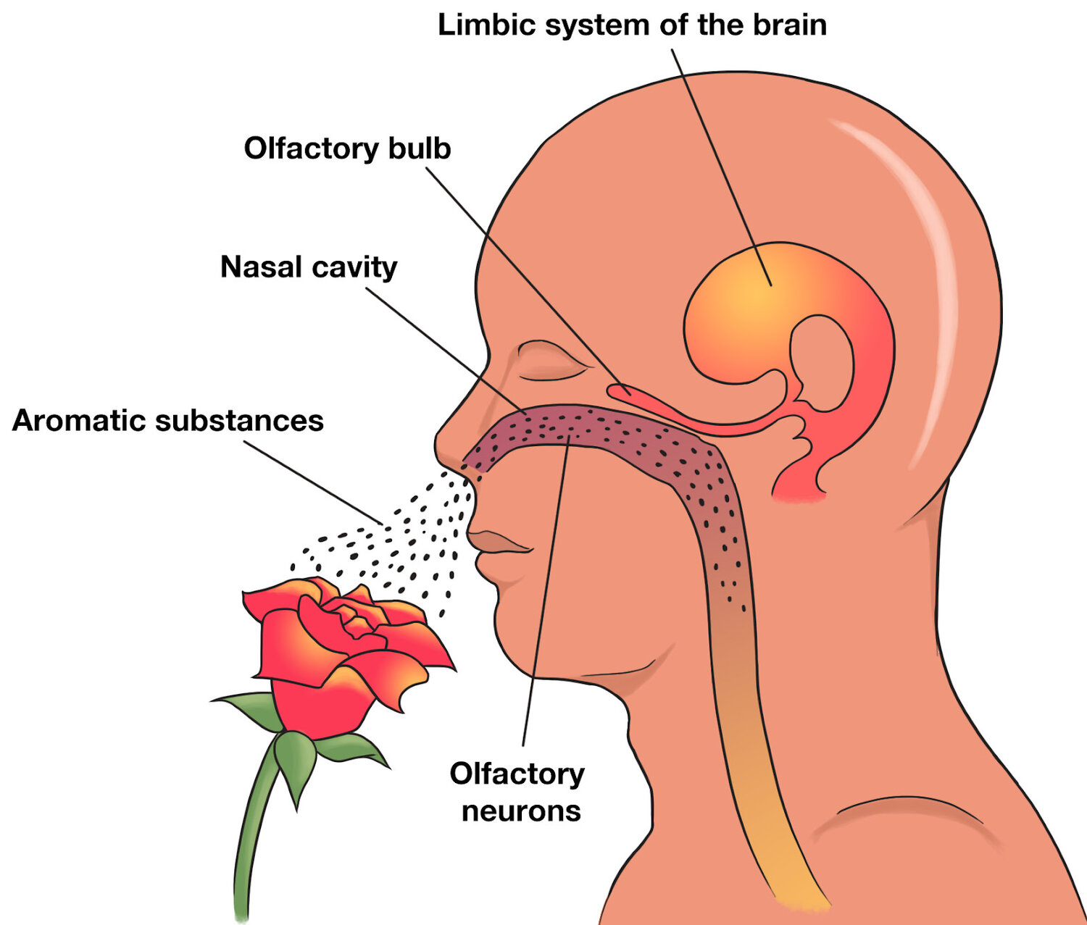
Method
Further research on sending scent-related signals to the brain must be done in order to immerse ourselves in the virtual world and achieve full-dive virtual reality, and such research must bear results that can be put to practice in devices that can interact with the brain.

Slide 21
Method
Arguably our least used of the five senses, our sense of taste can enhance our immersion in the virtual world but may not be necessary in most scenarios.
In an average day, we use our sense of taste while eating, drinking, and passively use it to taste our saliva.
It is less likely that we will attempt to put anything in our mouths or lick objects in the virtual world than in the physical world, but the moment that one attempts to do so in the virtual world will lose their immersion instantly.

Slide 22
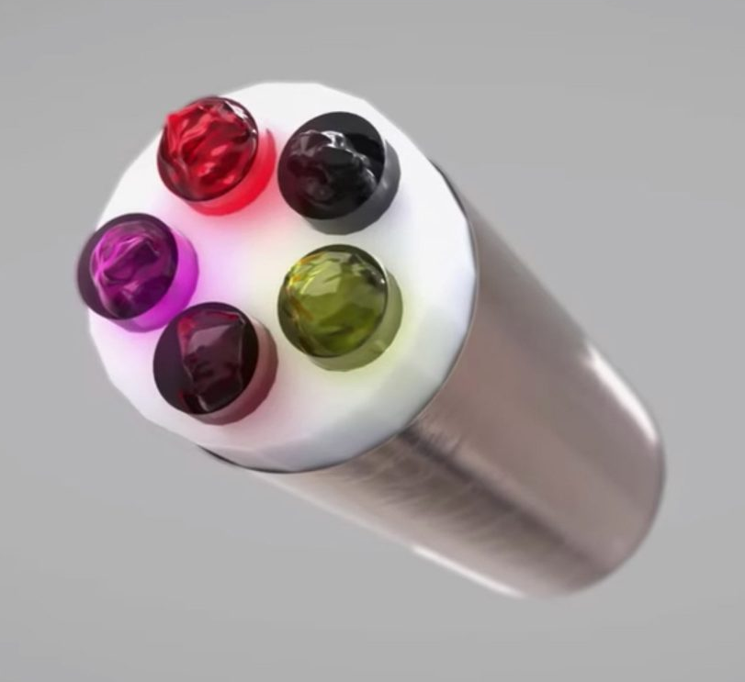
Method
Gustatory technology has accomplished outputting five general taste sensations (salty, sweet, sour, bitter, and savory) but fail to create entirely unique tastes using the technology alone.
As it stands, current technology is incapable of perfecting tastes that would aid in immersing us in the virtual world, and thus full-dive virtual reality is currently restricted to any situation that does not involve the sense of taste.

Slide 23
Method
As stated earlier, further research on sending and receiving signals to and from the brain can circumvent this issue, though future discoveries may change this.
Our overall sense of taste works in tandem with our sense of touch and smell, being manipulated by the texture of the entity in our mouth and what we are currently smelling.
I believe that with enough research on our sense of smell and touch, we may inadvertently make a discovery with our sense of taste as well, but only time will tell.

Slide 24
Method
In a hypothetical scenario where humanity has solved the issue of incorporating the five senses into virtual world technology, we will enter a new era where the virtual world begins to flourish more than it ever has.
However, there are still a few aspects of the human experience that must be addressed, or else a prolonged dive into the virtual world will eventually lose its initial burst of immersive awe.
One such issue is our emotions and emotional triggers, things that make us feel human.

Slide 25

Method
Fear plays a role in our everyday lives, from the fear of the unknown to fight or flight situations.
Our senses must be incorporated in such a way that danger feels like it will result in negative consequences.
In a combat-oriented situation, feeling a pinch in your arm when it is damaged can seem immersive, but numbing the limb and impairing its movement will feel more realistic, enhancing immersion even further.

Slide 26
Method
A virtual world that caters to our instincts can enhance immersion as well, such as providing cues that make us passively use our senses.
An example is feeling the warmth of an entity that is close to you but out of view, even if you would not know that entity is there otherwise.
Smelling a scent that originates from a distant location that has been carried to you by the wind, being unable to feel and move a limb that is not present and being affected by the weather are other examples of ways that full-dive virtual reality can further immerse the user that is not immediately apparent.
Once sufficient research has been conducted that will strip humans of their senses in the physical world and project them to the virtual world, and vice versa, full-dive virtual reality can be achieved.

Slide 27

Method
On top of our five senses and how they can be manipulated, there are aspects of a virtual world that, if matched with the physical world, can lead to even greater immersion in the full-dive virtual world.
If a virtual world lacks these aspects, it may not break immersion for the user, but adding these features will enhance the realism of the virtual world so that it is indistinguishable from the physical world.

Slide 28
Method
Entities should be unable to clip through any other entity unless it is known to be a hologram or other intangible object.
Instead, entities and surfaces should abide by the laws of physics, such as Newton’s laws of motion.

Slide 29
Method
Unlike teleconferences, chat rooms, and any other current form of group calls, the full-dive virtual world must feature an advanced proximity-based communication.
Depending on your distance to and from sources of sound, your voice should be louder or quieter.
This distance must be varied based on several conditions, such as objects between the speaker and listener, the characteristics of said objects, the movement of sound waves bouncing off surfaces, and the condition of the listener’s ears.

Slide 30
Method
Artificial intelligence (AI), if present, must be advanced enough to lack issues that arise with any non-playable characters (NPC) in a constructed environment.
Players that notice an NPC walking in place, getting stuck on an object, moving in unnatural ways, lacking proper emotions and expressions, lacking the adaptability to respond to complicated questions, or otherwise being inhuman can break immersion.

Slide 31
Method
There are countless factors that contribute to the overall immersion of virtual worlds, but there are some features that must be included that can take away from the total immersion of the full-dive virtual world.
An example is a system menu that changes settings and enables the user to “log off” of the full-dive virtual world, else the user would be unable to return to the physical world without external assistance.

Slide 32
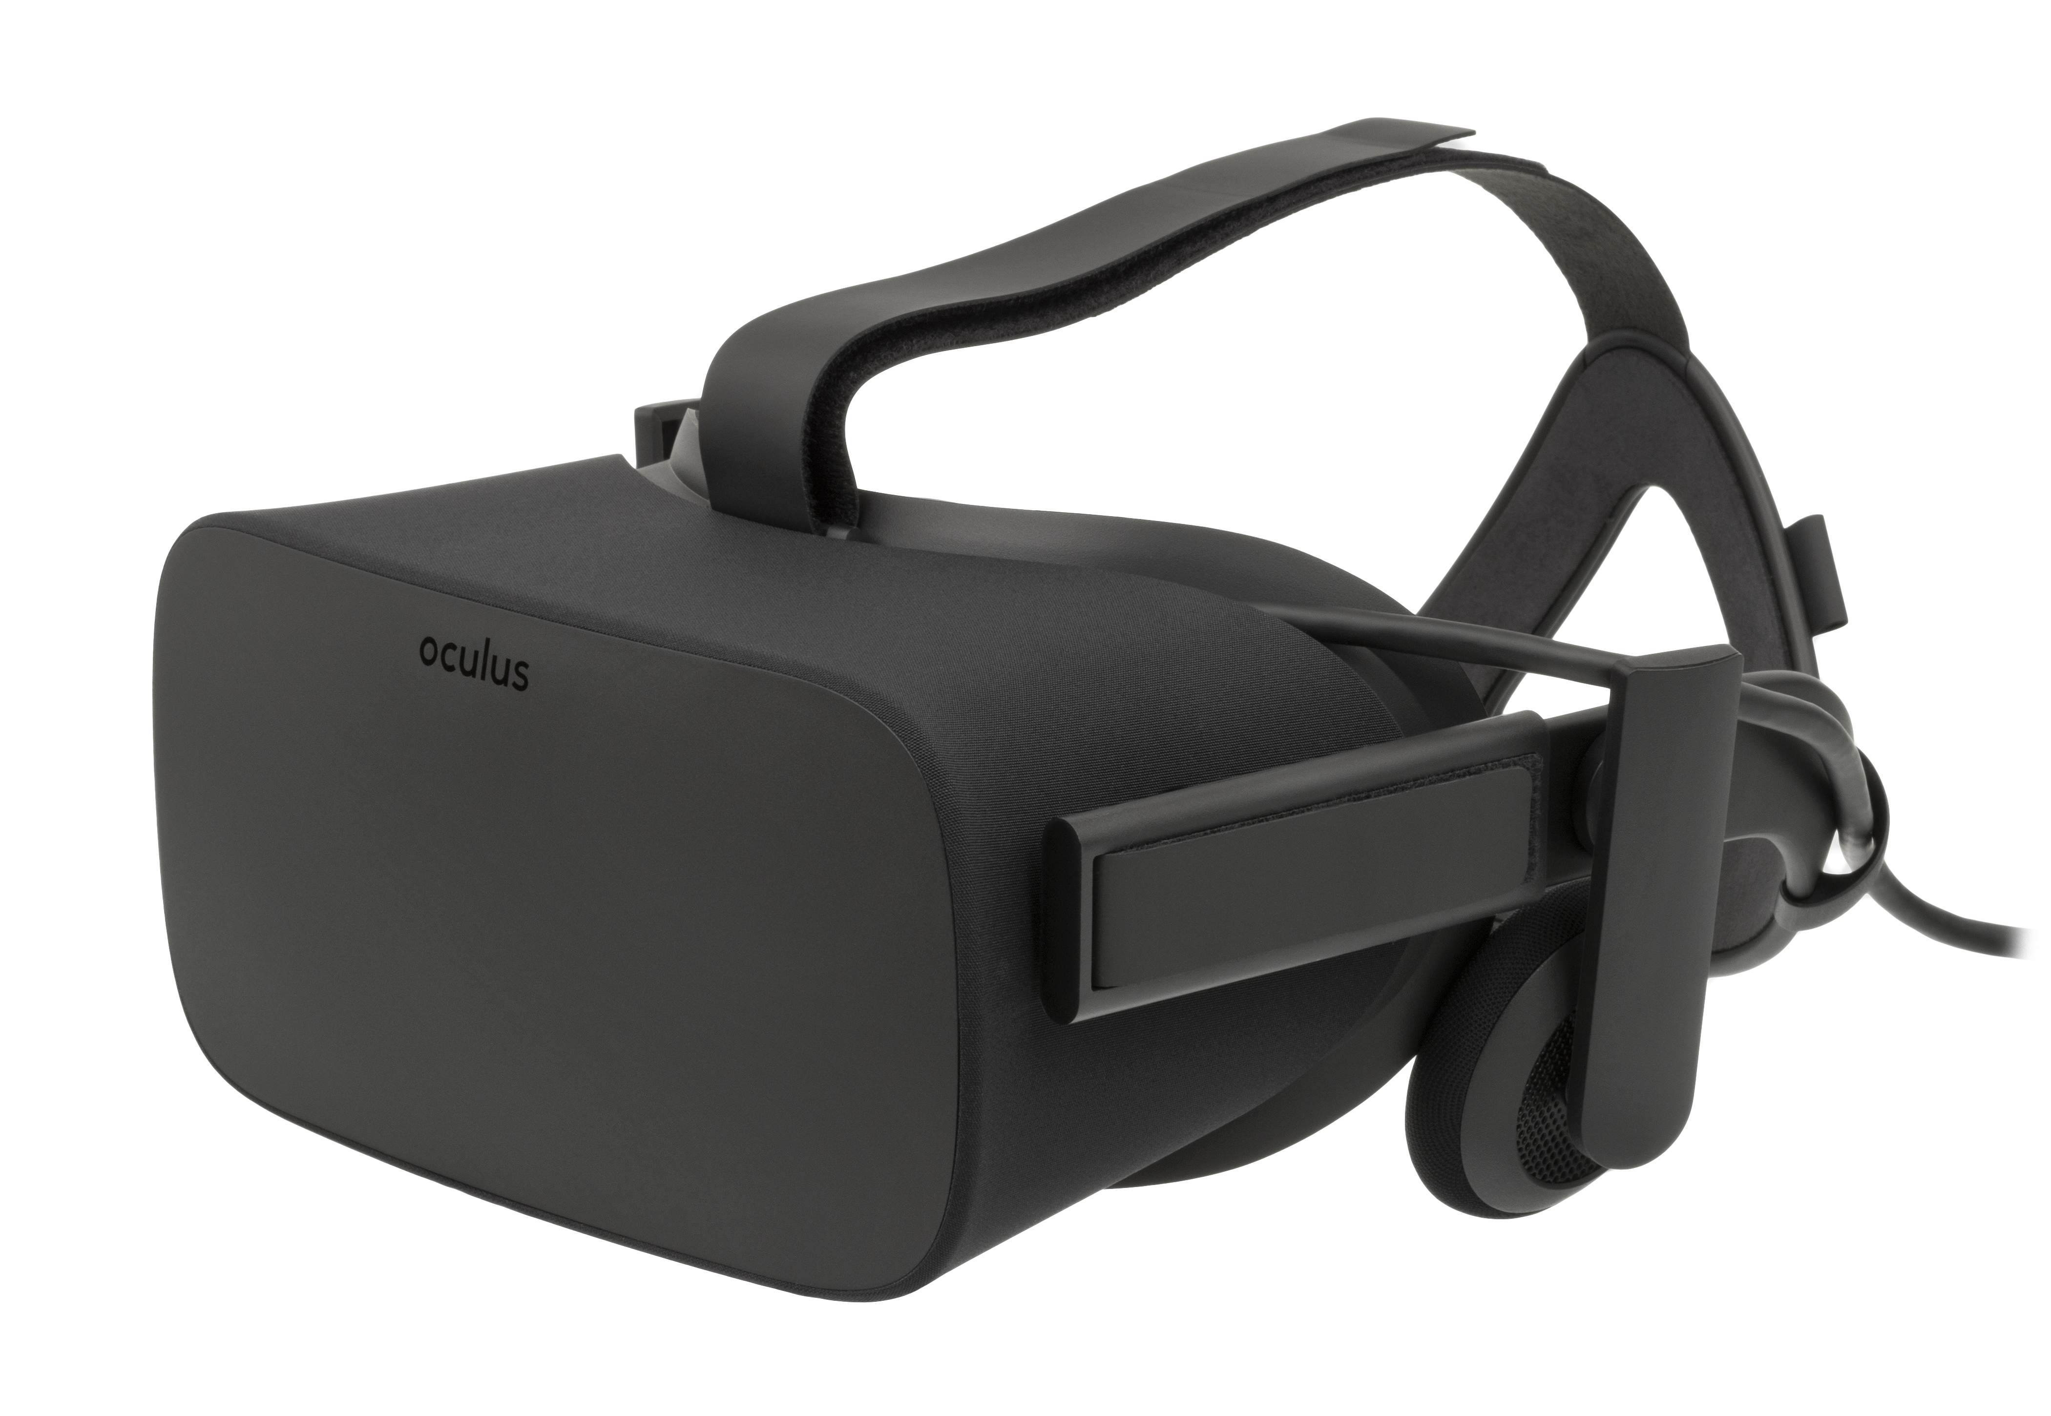
Results
It is currently not possible to achieve full-dive virtual reality.
With current technology, our senses of sight and sound are being utilized enough to immerse humans, but further improvement needs to be researched.
Our senses of touch and taste are being researched, but current devices catered to these senses come with significant drawbacks.
Our sense of taste is also being researched and no device exists that utilize the sense of taste properly.

Slide 33
Results
Human emotions and instincts must be incorporated in the virtual world to achieve full-dive, but they cannot be properly incorporated without the five senses being present.
The laws of physics that apply to the physical world and other logical features can also be applied to the virtual world to further enhance immersion, though full-dive must be achieved on a fundamental level before they make a substantial difference in the grand scheme of the virtual world.

Slide 34
Conclusion
To properly achieve full-dive virtual reality, the five senses must be researched extensively, especially the sense of touch.
Technology that makes proper use of all five senses must be invented, and the resulting devices must have minimal drawbacks, else immersion can be broken in certain situations.
With our current knowledge, making direct connections with the brain to input and output data will be more efficient than creating external gadgets that collaborate to make a pod of sorts to achieve full-dive.

Slide 35
Conclusion
Once the five senses are successfully incorporated into full-dive technology, we must build a virtual world that not only enables us to use our senses as freely as in the physical world, but also be logical enough to be indistinguishable from the real world.
This will take an immense amount of power and research. Current pursuits of VR, AR, MR, and XR contribute to this cause, directly or indirectly.

Slide 36
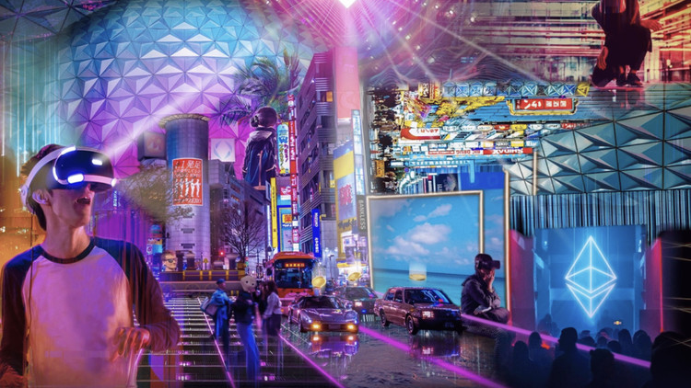
Discussion
With full-dive virtual reality achieved, humanity will enter a new era pertaining to the virtual world.
Traditional VR will become obsolete, much the same as how flip phones became obsolete as smartphones became more affordable.
AR will rise in its place, and existing devices and structures will continue to incorporate AR in more ways.

Slide 37
Discussion
MR will also rise to relevance, and with proper planning, full-dive VR and MR may be bridged through various applications.
Society will be full of so much technology that it will be nigh impossible to avoid it, and the eldest living generation will consist of those who grew up with smartphones.
Technology from past generations, such as the pen and paper, may become obsolete in favor for digital tablets and styluses.

Slide 38
Discussion
Movies like Ready Player One depict a futuristic world that changed drastically as virtual worlds became mainstream, and while the drama in it is dramatized for entertainment purposes, it displays just how lucrative virtual worlds are seen today.
The development of the Metaverse is a result of such intrigue, as every large tech company has at least acknowledged its existence.

Slide 39
Discussion
Animated series like Sword Art Online depict a world that is being introduced to full-dive virtual reality, and putting the fictional conflicts aside, it displays the exponential growth of technology and diverse use and interest in the field of virtual worlds.
Once a technological breakthrough has been achieved in our physical world, several other breakthroughs will occur at an increasing rate along with public interest in it.

Slide 40
References
Minrui Xu, Wei Chong Ng, Wei Yang Bryan Lim, Jiawen Kang, Zehui Xiong, Dusit Niyato, Qiang Yang, Xuemin Sherman Shen, Chunyan Miao. (2022). A Full Dive into Realizing the Edge-enabled Metaverse: Visions, Enabling Technologies,and Challenges. https://arxiv.org/abs/2203.05471.
Nicole C. Huff, David J. Zielinski, Matthew E. Fecteau, Rachael Brady, Kevin S. LaBar. (2010). Human Fear Conditioning Conducted in Full Immersion 3-Dimensional Virtual Reality. https://www.jove.com/t/1993/human-fear-conditioning-conducted-full-immersion-3-dimensional.
Andrei O. J. Kwok, Sharon G. M. Kohb. (2020). COVID-19 and Extended Reality (XR). https://www.tandfonline.com/doi/full/10.1080/13683500.2020.1798896.
Steve Benford, Chris Greenhalgh, Gail Reynard, Chris Brown, Boriana Koleva. (1998). Understanding and constructing shared spaces with mixed-reality boundaries. https://dl.acm.org/doi/abs/10.1145/292834.292836.
Jianghao Xiong, En-Lin Hsiang, Ziqian He, Tao Zhan, Shin-Tson Wu. (2021). Augmented reality and virtual reality displays: emerging technologies and future perspectives. https://www.nature.com/articles/s41377-021-00658-8.

